Slide 1
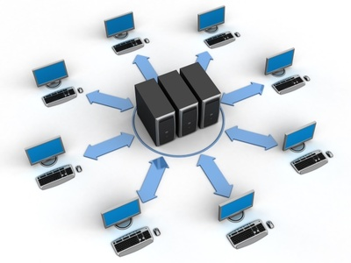
Network Fundamentals
Network fundamentals part 1

Slide 2
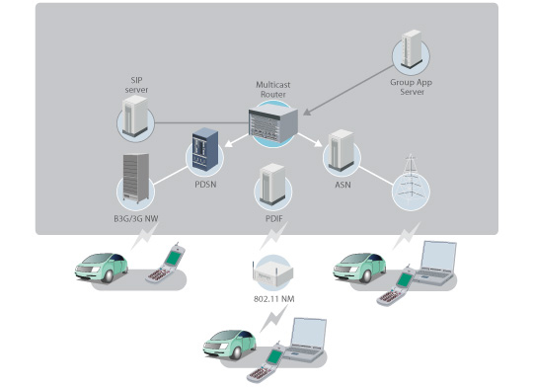
Objectives:
What’s a network, and some network applications.
Network design Classification.
Network classification techniques.
Network devices and their applications.
Challenging test.

Slide 3
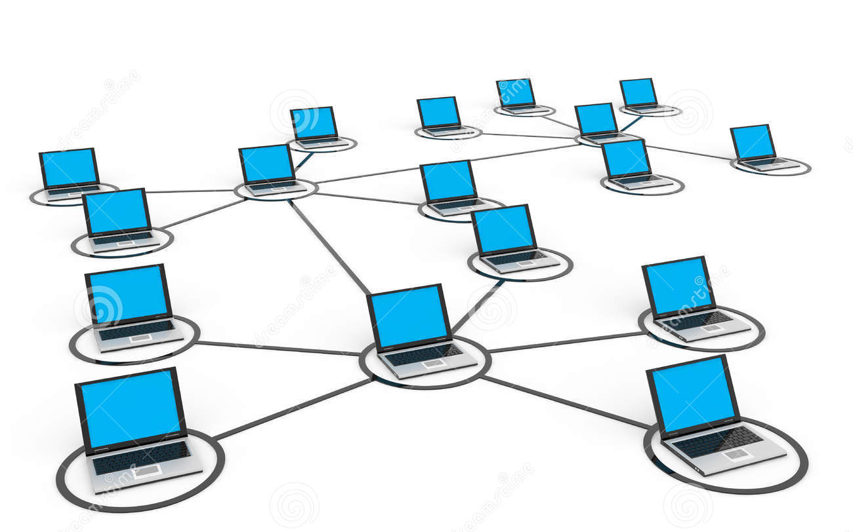
What’s a network, and some network applications:
A network is called at any system that has its devices are linked and connected, in a way that allows data can move between them.
We can classify networking into two general levels, software and hardware level.
Network technology is implemented in a wide range of market scope.
Internet is the golden example, why.

Slide 4
Network design Classification:
LAN
CAN
MAN
WAN

Slide 5
Network design Classification:
LAN
Some PCs that are linked together with a switch.
CAN
It consists of some LANs that are connected together.
MAN
It consists of some CANs that are connected together.
Geographically it’s the network implemented in the government.
Geographically it’s the network implemented in a small office or building
Geographically it’s the network implemented in a university.
WAN
It consists of some MANs that are connected together.

Slide 6
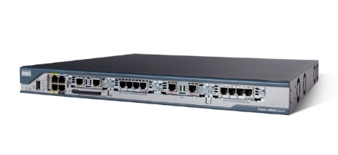
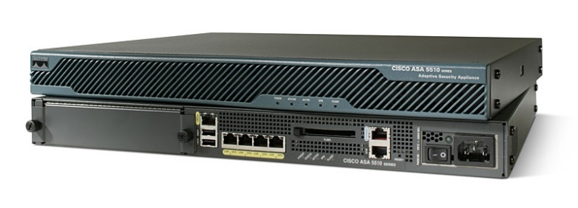
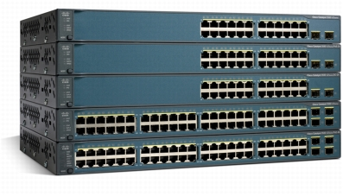
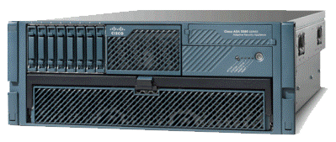
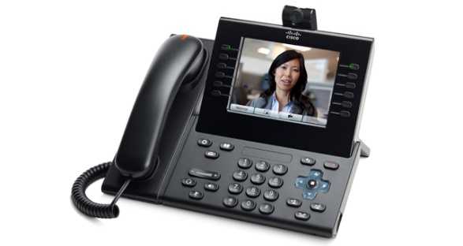
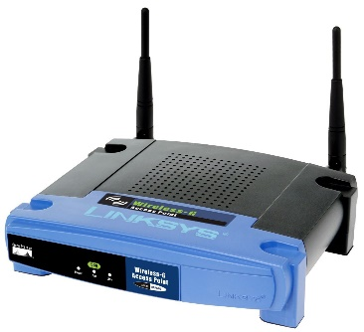
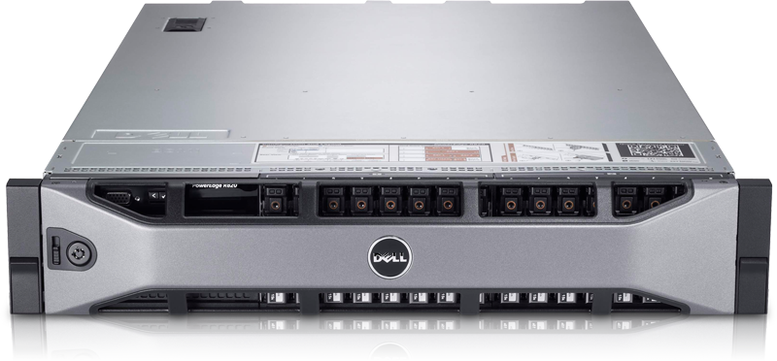
Network devices and their applications:
Switch
Router
IPS/IDS
Server
IP-Phone
Access Point
Firewall

Slide 7
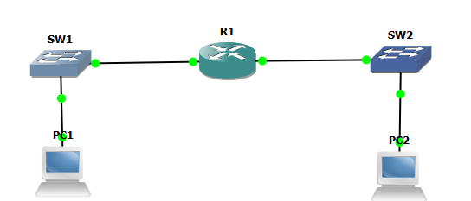
Network devices and their applications:
Some switch’s functions:
1-Connecting PCs together to create a LAN.
2-Connecting other devices than PCs, as IP-Cameras, IP-Phones and more.
C3750
LAN-1
LAN-2

Slide 8
Network devices and their applications:
Some router’s functions:
1-Connecting LANs together.
2-Connecting your entire network to the internet.
2-Multifunctional device as It can operate as a firewall, switch, IPS/IDS, unified communication server and more.
C2801
LAN-1
LAN-2

Slide 9
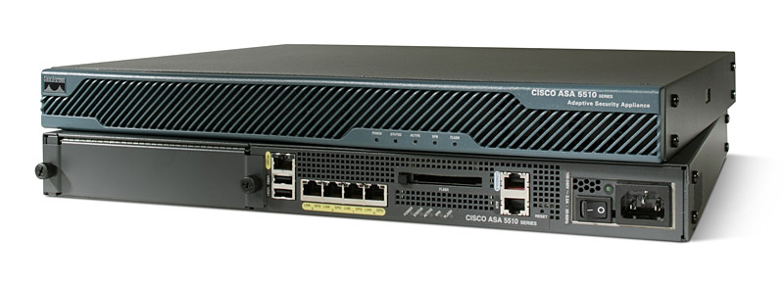
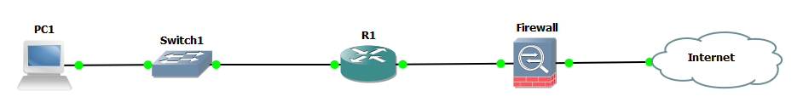
Network devices and their applications:
Some firewall’s functions:
1-Filtering packets coming in/out the network.
2-Controlling authentication/authorization of the network users.
3-In common designs, it’s configured to be in face of the internet.
CISCO ASA 5510
Inside
Outside

Slide 10
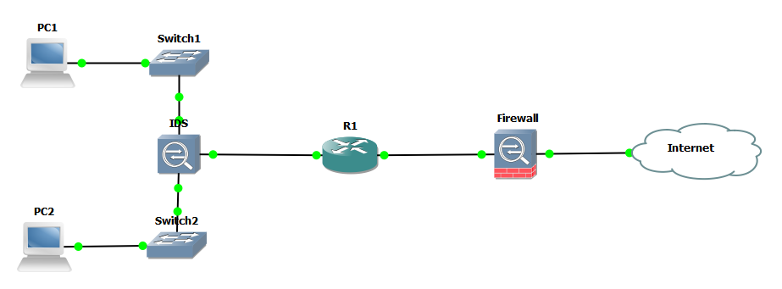
Network devices and their applications:
Some IPS/IDS’s functions:
1-Working on monitoring packets moving between PCs in the entire network.
2-IDS stands for “Intrusion Detection System”, and it scans the network for detecting attacks but it doesn’t stop them.
3-IPS stands for “Intrusion Prevention System”, it scans the network for detecting attacks and also stops them.
CISCO IP 4270

Slide 11

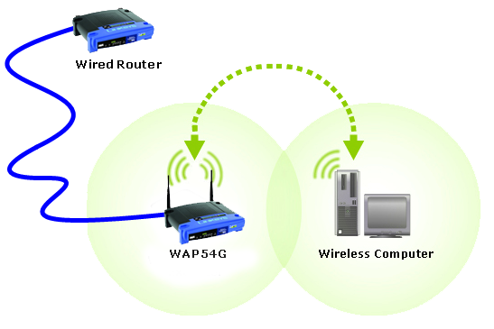
Network devices and their applications:
Some access point’s functions:
1-It has the same switch’s functions, but it connects PCs together wirelessly.
2-Why it’s considered to be a matter of danger.
CISCO LINKSYS

Slide 12
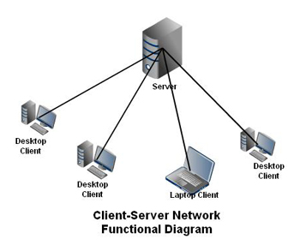
Network devices and their applications:
Some servers’s functions:
1-The server works as a supplier for PCs whether they’re on the same LAN or across WAN, for many services, like to be a web, mail, dhcp server and more.
2-Cisco has recently started the servers industry with its UCS series.
DELL POWEREDGE R620

Slide 13

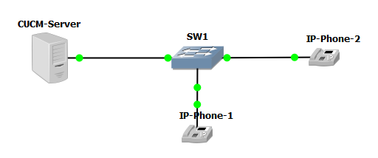
Network devices and their applications:
Some IP phone’s functions:
1-Works with the great VOIP “voice over IP” technology.
2-Used a lot in companies, banks and schools.
CISCO IP-Phone 9900

Slide 14
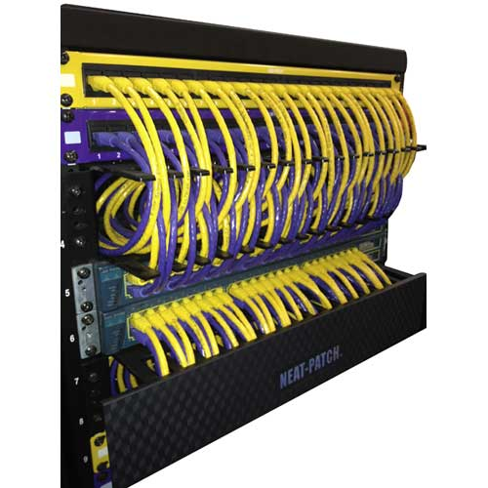
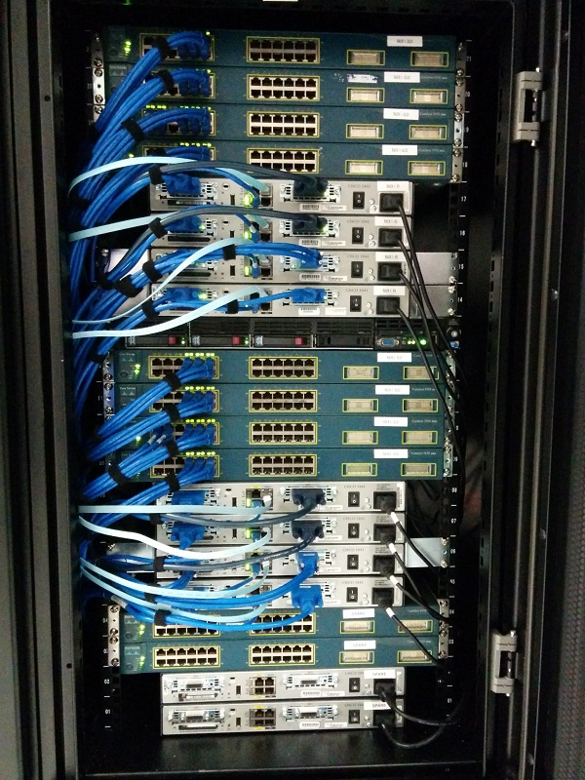
Network devices and their applications:

Slide 15
Objectives:
What’s a network, and some network applications.
Network design Classification.
Network classification techniques.
Network devices and their applications.
Challenging test.

Slide 16
CCNA Routing & Switching
Network fundamentals part 1

